Slide 1
PROBLEM OVERVIEW:
The open access of the Internet and all web-based services such as Online Banking are inherently prone to risks which includes online theft of the User ID/User Name, Password, virus attacks, hacking, unauthorized access and fraudulent transactions.
.
Security and Identification of Concerned theft.
Inconvenience in Banking and its procedure
Time delay in transactions.

Slide 2
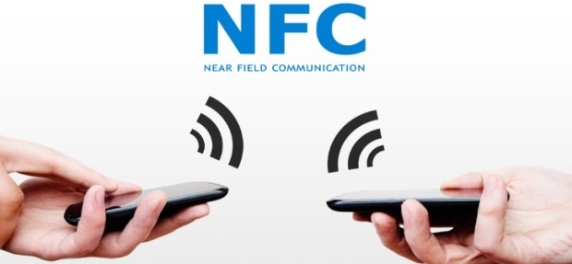
OUR PROPOSED SYSTEM:
we are using card emulation method and tag reader/writer method in NFC for our convenience.
But in this we are using Peer-to-Peer method for the application.
In peer-to-peer mode data commutes between two NFC enabled active devices. But it is rarely used because of tough competition given by other wireless technologies like Bluetooth as it is more widely spread compared to NFC.
There are payment transaction using NFC already existed. But there is no any specific application for that.
Our propose solution is to build an enterprice banking system with centralized cerver in order to give feasible transaction .we are incorporating nfc based devices for transaction.application for the transaction, it makes it easy enough for even the nontechnical persons to use them.

Slide 3
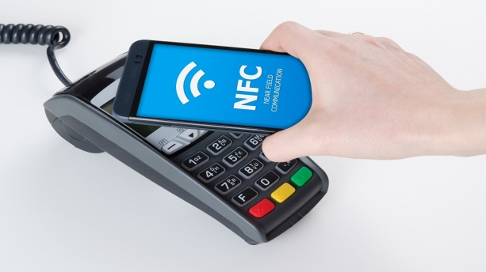
Applications:
Using our mobile device NFC as one of service adder to get benefits on contact less banking.
Need to develop application based on NFC.
Creating a global wallet and connect with this application so that the banking process will be centralized
Creating a centralized server for our digital transaction which contain all the mandatory data, necessary for the transactions.
Making the currency as digital.
Making an application for reliable transaction.

Slide 4
Problem finding:
Everry time we cound not reliable on paper curreny.

Slide 5
TECHNOLOGY STACK:
COMPUTE POWER : Google Cloud Computing.
Progaraming languages:java
Web technologies:html,css,ajax(scripting lang)
Database :mysql
transaction app: Flutter application can be built which will be using NFC or RFID to communicate each other.

Slide 6




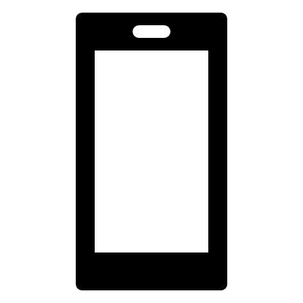



FLOW DIAGRAM:
Bank Server
Payment Server
Mobile with NFC
Point of Sale
Contactless Reader

Slide 7
ccloud based banking system:
When both reader and payment devices are close together and activated, then there is an exchange of encrypted data from the NFC chips which completes the payment.
This process makes the checkout within a blink, thus making NFC payments as one of the most secure and convenient payment methods.
The contactless connection between the two devices is established with the help of radio waves which are similar to RFID labels that are used in warehouse, store, and other wireless tracking applications. NFC chips use a specific RFID frequency of 13.56MHz that works only when both the chips are placed very close to each other.
Many digital eWallet payment apps use NFC for added security as digital wallets only communicate with NFC readers when the user unlocks the app on the device and selects the payment card to be used for payment.

Slide 8
ADVANTAGES OF PROPOSED SOLUTION :
More secure since NFC transaction Middle Man in the attach would be tevious
Highly avilablity
Contact less transaction
Control with financial regulations based on the country /regional government can be made.
End to end encryption.
Hacking would be difficult due to survillance .

Slide 9
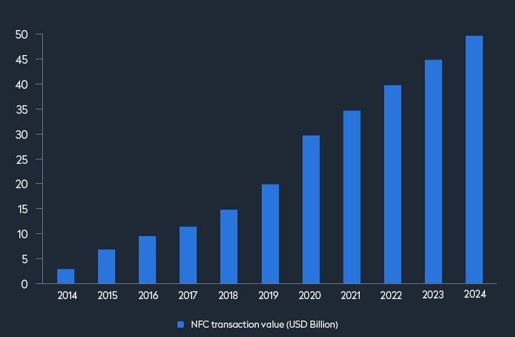
FUTURE ENHANCEMENT:
This Project can be connected with any of cloud Technology and can have end-to-end encryption algorithms added to have strong security.
Also we can have disaster recovery management for this project in which we will have multiple region deployment serves across the globe In which we can restore the transaction servers within few minutes without affecting the customers.

Slide 10
CONCLUSION:
Digital transformations have changed the world and each startup has embraced the contactless payment frameworks. In the future, we will pay with our phones and NFC applications are the ticket to that wonderful future. Because of the numerous current MasterCard information breaches, now is a great time to use a solution that shields our wallets from robbery and fraud.

